Slide 1

TMS: Tours management system
Let’s Travel the Gujarat with Us

Slide 2



Make a Plan
Set a destination and/or travel theme
1
Set travel dates, mode of travel, and find accommodations
2
Find local attractions, food venues, and activities
3

Slide 3
Member Details
Guide Name:-
Chaitali Patel
Programmers :-
Jariwala Vaibhav P.
Gadiluhar Chandrakant D.
Kazi Hamza Athar.
Gurjar Piyushkumar A.

Slide 4
Introduction:-
Tourism has turned out to be an economic booster contributing to the economic development of many countries over the last few decades. People see holidays as a necessity, and not as luxury in the present scenario. Tourism calls for coordination and cooperation between travel agents, tour operators, and tourists. Tourism has a few major elements − destinations, attractions, sites, accommodation, and all ancillary services.

Slide 5
Abstract
Tourism Management System is a complete tourist fully integrated tourism web site. The website covers all the areas required for an including tourism, This project is developed to manage the tourist in the tourism management web site. The main module in this project are login, tourist management, complaints and feedback.
Includes:-
Registration Form for membership(Notification).
Packages.
Budget estimate and places.
All total estimate of places user selected.

Slide 6
Hardware and Software Requirement
Software Requirements:
• Windows X, Windows
• Xampp control panel (Database).
• Visual studio 2022 (ver.1.72)
Hardware Components:
• Processor – Quad-Core
• Hard Disk – 256 GB
• Memory – 8GB RAM

Slide 7
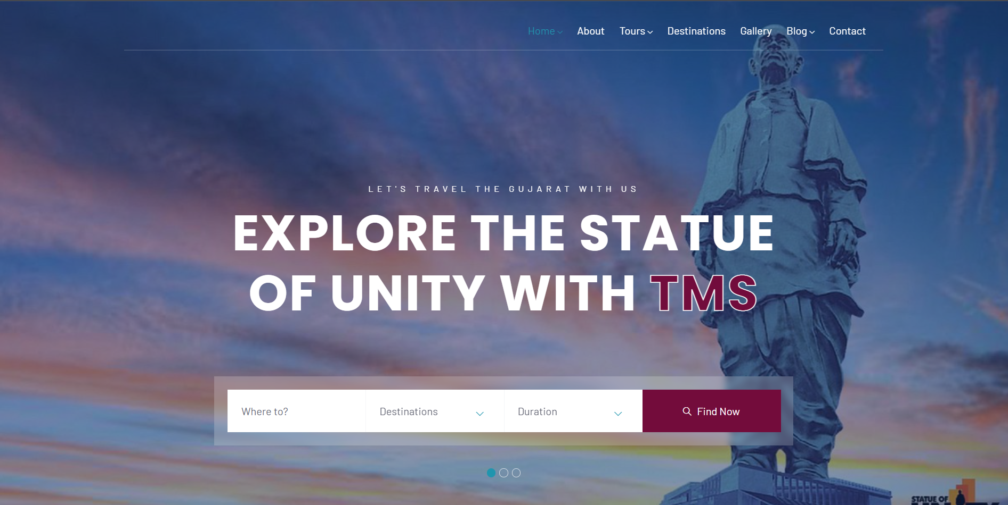
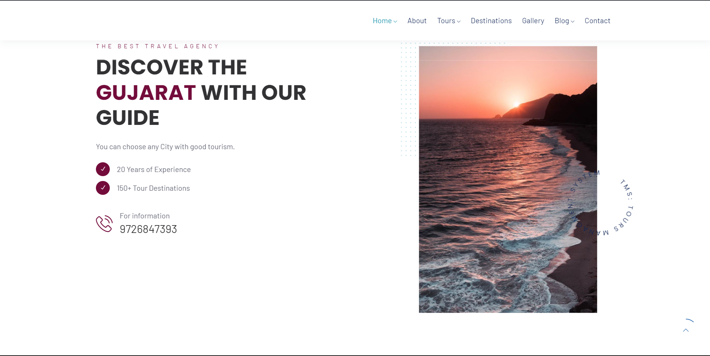
Snap shot of working Module.

Slide 8
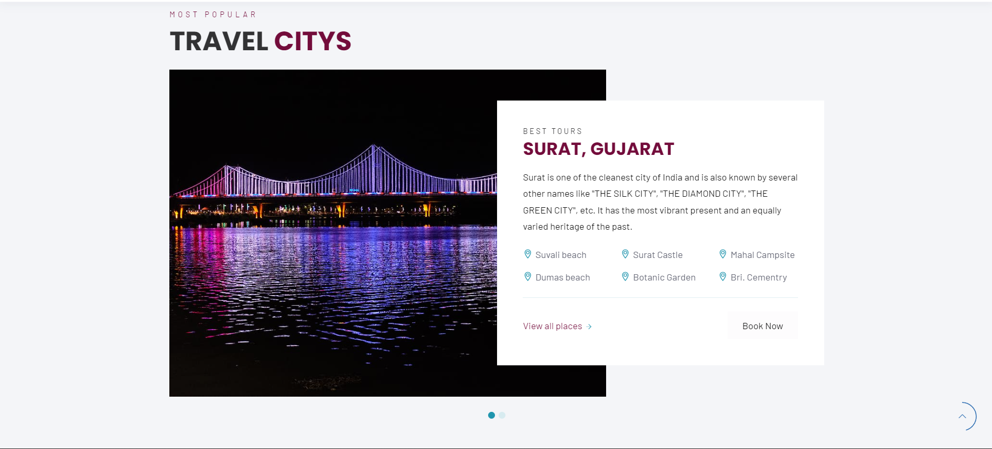
Snap shot of working Module.

Slide 9
Advantages and Disadvantages.
Advantages
Disadvantages.
Budget Estimate available.
Flexible Interface.
Easy to use and Attractive website.
Packages (offers).
Student level website.
Only Gujarat state base.
Booking not available for Transportation.
Payments system not available.

Slide 10
Future Scope
Budget Estimate :-
Places display to user as per user given Amount.
Type of Places:-
The places display as per user search. (Heritage, Cultural, Beach, Hill station, Temples, Palaces, etc.)
Hotel Booking available.

Slide 11
Conclusion.
Conclusion Tours management system proves to be a strong system which has followed all the industrial standards. The functional dependencies are also listed. Working with such a system can enable the user to get any information with low performance cost and increased throughout. As the database is created with good design, the system can comply with any demand in the future. The most widely used complex queries are also stated above. Also, the relational algebraic translation proves that the database is designed properly.

Slide 12

Thank you
TMS@gmail.com

